Slide 1
Color Palettes and Design
Mr Mack 2021

Slide 2
Overview
In this learning activity students add color to the drawing they made in activity 1. They learn to apply the background, fill, and stroke functions (used in scales of gray until now), to define colors and add transparency. Both the RGB (Red, green, blue) and HSB (Hue, Saturation, Brightness) color models are applied.
Students apply the programming concepts they learned in the previous unit (variables, randomness) to color manipulation, defining color ranges and palettes.

Slide 3
Objectives
Students will be able to:
Understand how to pick a color palette and use color wisely.

Slide 4
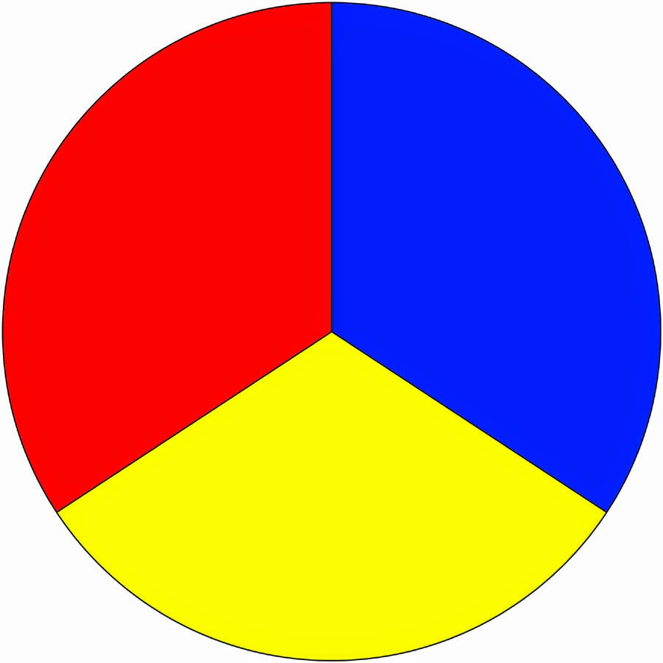
HSB Color
As you'll be using color often, you may want to familiarize yourself with color terms and different palettes that are pleasing to the eye. You should be familiar with the following:
Color palette - in the digital world, refers to the full range of colors that can be displayed on a device screen or other interface.
Primary Color - any of a group of colors from which all other colors can be obtained by mixing.

Slide 5
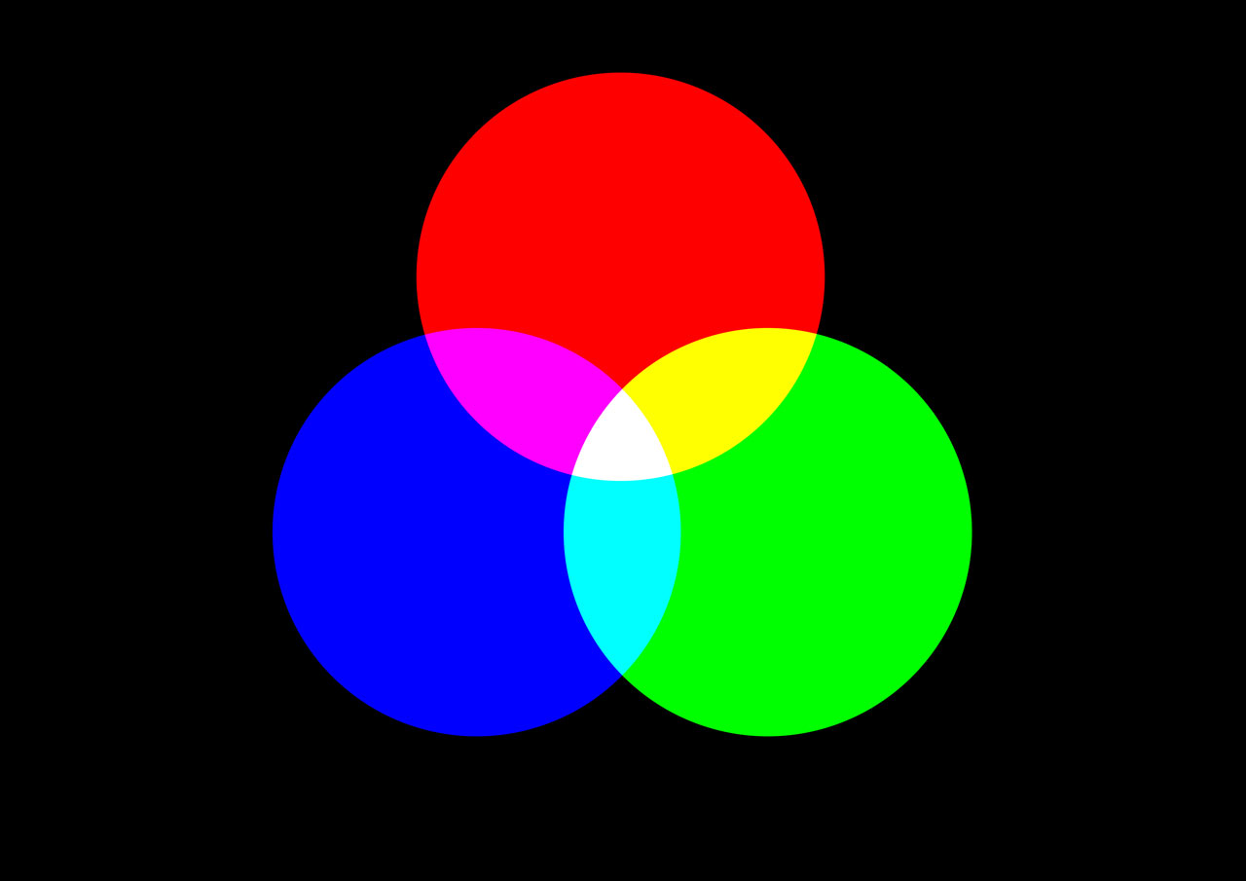
HSB Color
Secondary Color - a color resulting from the mixing of two primary colors.

Slide 6
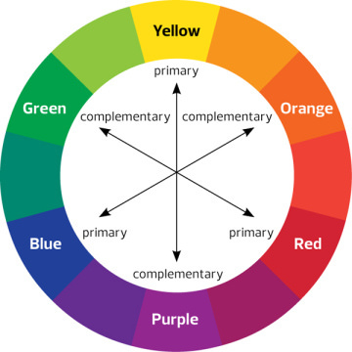
HSB Color
Accent Color - are colors that are used for emphasis in a color scheme.
Complementary Colors - colors directly opposite each other in the color spectrum, such as red and green or blue and orange, that when combined in the right proportions, produce white light.

Slide 7
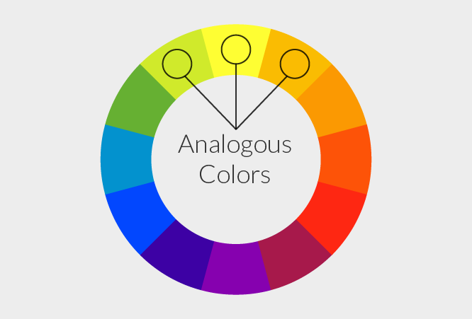
HSB Color
Analogous Colors - groups of three colors that are next to each other on the color wheel, sharing a common color, with one being the dominant color, which tends to be a primary or secondary color, and a tertiary. Ex. Red, orange, and red-orange.

Slide 8
Practice
Use Paletton or Adobe Color Picker to come up with your palette.
Try to be mindful of what colors you are using more and less than others.
Pick a previous project (from LA1 or LA2) and colorize it only using colors from a color palette.

